Slide 1
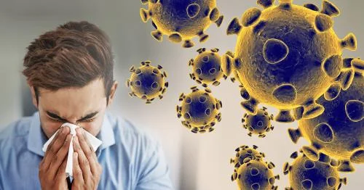
THE COVID 19 STORY
Mitali Mendes
Debasri Mitra
Elisa Ahern
May 01, 2020
Immersive Data Analytics
Notes:
COVID - 19 is such a commonly discussed topic today. Since our team decided to take up this topic for our group project, the three of us conducted extensive research and had a self realisation that there was so much we each did not know - COVID is much more fatal than the seasonal flu, the carriers from bats to human may have been a another animal known as Pangolins.
This project was conducted keeping in mind five years from now, we look back at the presentation and get a better understanding of the COVID pandemic.

Slide 2
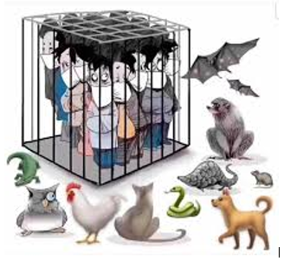
OVERVIEW
Goal
About the Virus
Vocabulary, Background, Transmission, Infection Rate, Pandemic Lifecycle
Data Analysis
Understanding Data Attributes, Visualization, Map Analysis
Growth Rate, Predictive Analysis: Linear Regression, SVR, Winter Holt Regression
Conclusion
Notes:
Vocabulary, Background, Transmission, Infection Rate, Pandemic Lifecycle
Data Attributes, Analysis, Prediction - Recovered Cases, Active Cases, Growth Rate, Linear Regression,
SVR, Winter Holt Regression

Slide 3


GOAL
What trends are we seeing earlier and now?
Build a model that can predict recovered cases knowing confirmed cases and deaths.
Predict number of recovered cases at a given date.
Notes:
All of us around the world today naturally want to know when the COVID-19 pandemic will end.
Estimating the end dates has been subconscious for most people.
Our existing knowledge of historical pandemic process patterns,and the continually accumulating data of the current pandemic makes it possible to take a model based, and data-driven approach to objectively predicting recovered cases.
Data of the number of confirmed cases and deaths will be used to predict recovered cases at a later date.

Slide 4
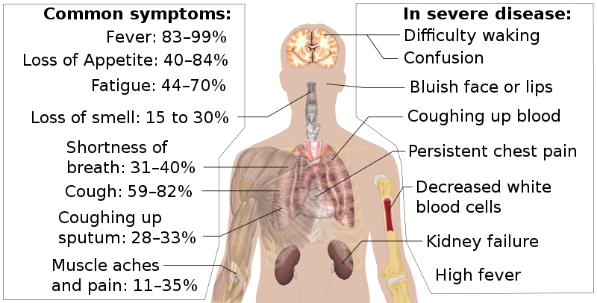
COVID-19 VOCABULARY
VIRUS
Severe Acute Respiratory Syndrome Coronavirus 2, (SARS-CoV-2)
DISEASE
Coronavirus Disease, (COVID-19)
Notes:
Here we talk a little about COVID 101. COVID - 19 is the disease caused by the virus SARS-CoV-2 which causes respiratory illness.
What we know is that the virus can spread from person to person.
Good hygiene can decrease the growth of the virus and prevent infection.
The image has some common symptoms like fever, loss of smell, appetite, fatigue, muscle ache and pain etc. More recent cases of COVID - toes, red rashes on the toes in teenagers were some early symptoms.
More severe symptoms include confusion, kidney failure, difficulty breathing, decresaed white blood cells etc.

Slide 5
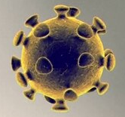

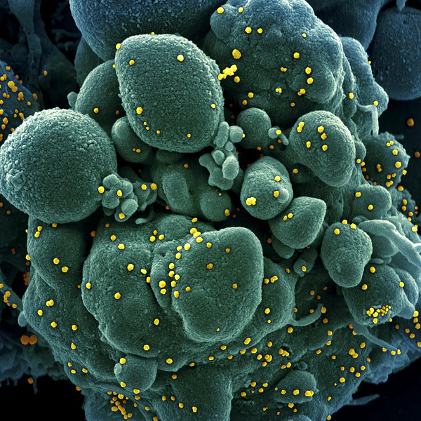
WHAT IS CORONAVIRUS ?
‘Corona’ means crown; Looks like the sun with its corona under a microscope
‘Novel’ - animal to human to human; humans have no prior exposure, no immunity
Notes:
The name 'coronavirus' has to do with what the virus looks like under a microscope. The word 'Corona' is a Latin word which means crown. All coronaviruses have a similar structure.
the virus is called 'novel' because it started with an animal population, and then transmitted to a human and now it can go from human to human.

Slide 6

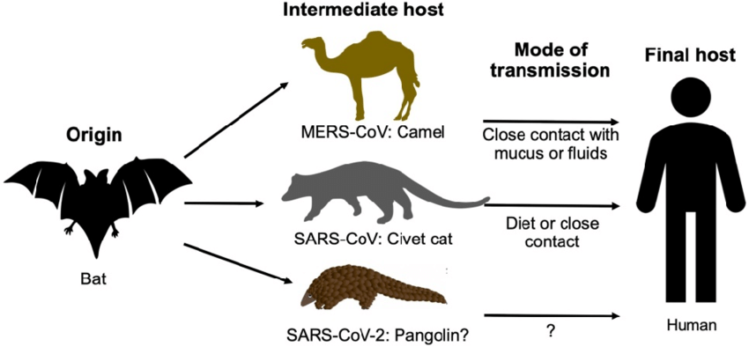
TRANSMISSION
Notes:
Viruses that circulate in animals keep jumping over to infect humans. The story of COVID is no different than the story of HIV that came via the Chimapanzees’s in West Africa,
MERS from bats via camels in the Middle Eastern region
Ebola from Fruit bat via gorillas and pig,
and even the most ancient of them all - measles came from bats and rodents.
These are all diseases that have been introduced to humans causing deadly effects — all via animals.
Common theory suggests that key reservoirs and mode of transmission of coronaviruses were the bats.
The consumption of infected animal as a source of food is the major cause of animal to human transmission of the coronavirus and due to close contact with an infected person, the virus is further transmitted to healthy persons.
The current outbreak is thought to have started in a food market in Wuhan, China. But uncertainties remain: Researchers are still not sure which animal started the outbreak. DNA evidence suggests it’s likely related to bats (which also were the origin of the SARS coronavirus outbreak in 2003).

Slide 7
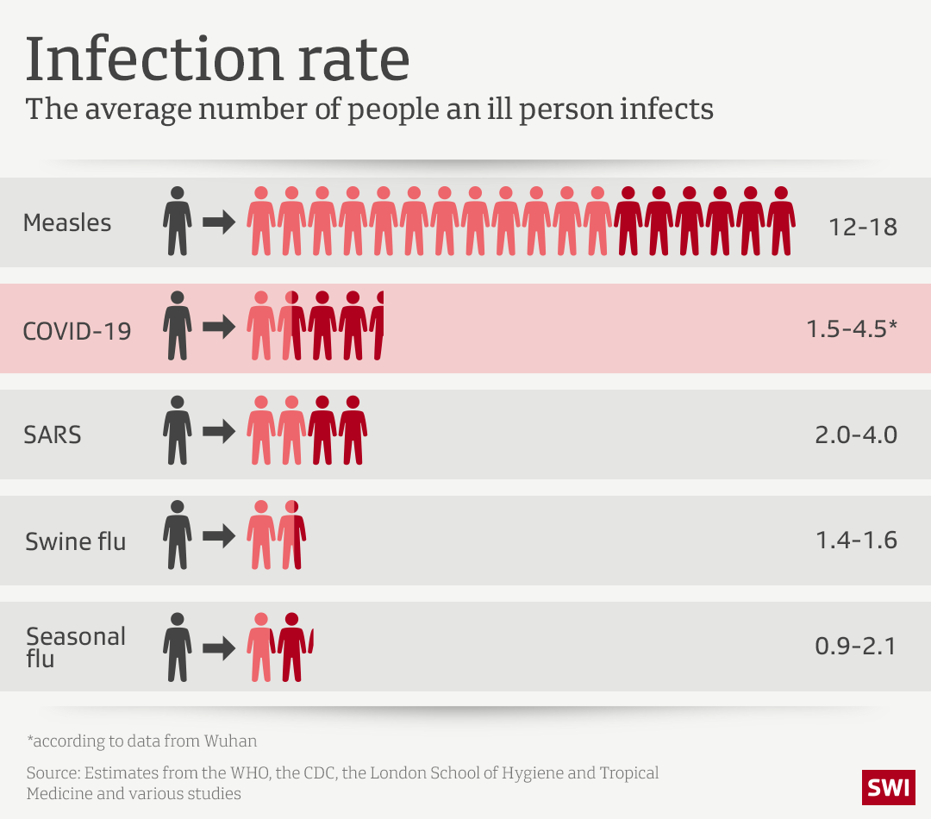
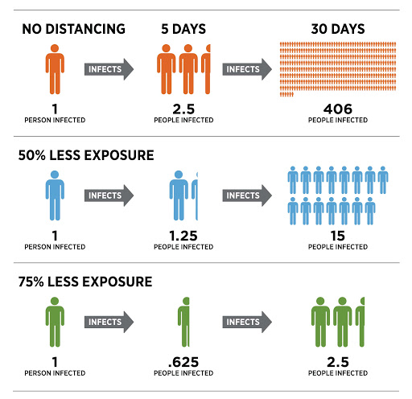
INFECTION RATE
Notes:
The World Health Organization (WHO) and other sources are estimating the infection rate of COVID-19 is higher than seasonal flu, swine flu and SARS but considerably lower than measles
A crucial metric called R0 ( R-naught), represents how many people an average person with a virus infects.
The coronavirus has an R0 of roughly 2 to 2.5, meaning that each new person spreads the disease to about 2.2 people on average.
The good news is that a disease's R0 is not fixed — and can be decreased with the right preventive measures. When experts strategize about how to end the pandemic, their goal is to bring the R0 below 1, which would put the coronavirus in decline until it dies out and puts an end on the pandemic.
The second image here talks about the importance of physical distancing. When a contagious person does not maintain any distancing, in 30 days he or she can infect upto 406 persons. On the other hand if a contagious person maintains extreme physical distancing may infect only 2.5 persons in 30 days and thus contributes positively to end the pandemic.

Slide 8
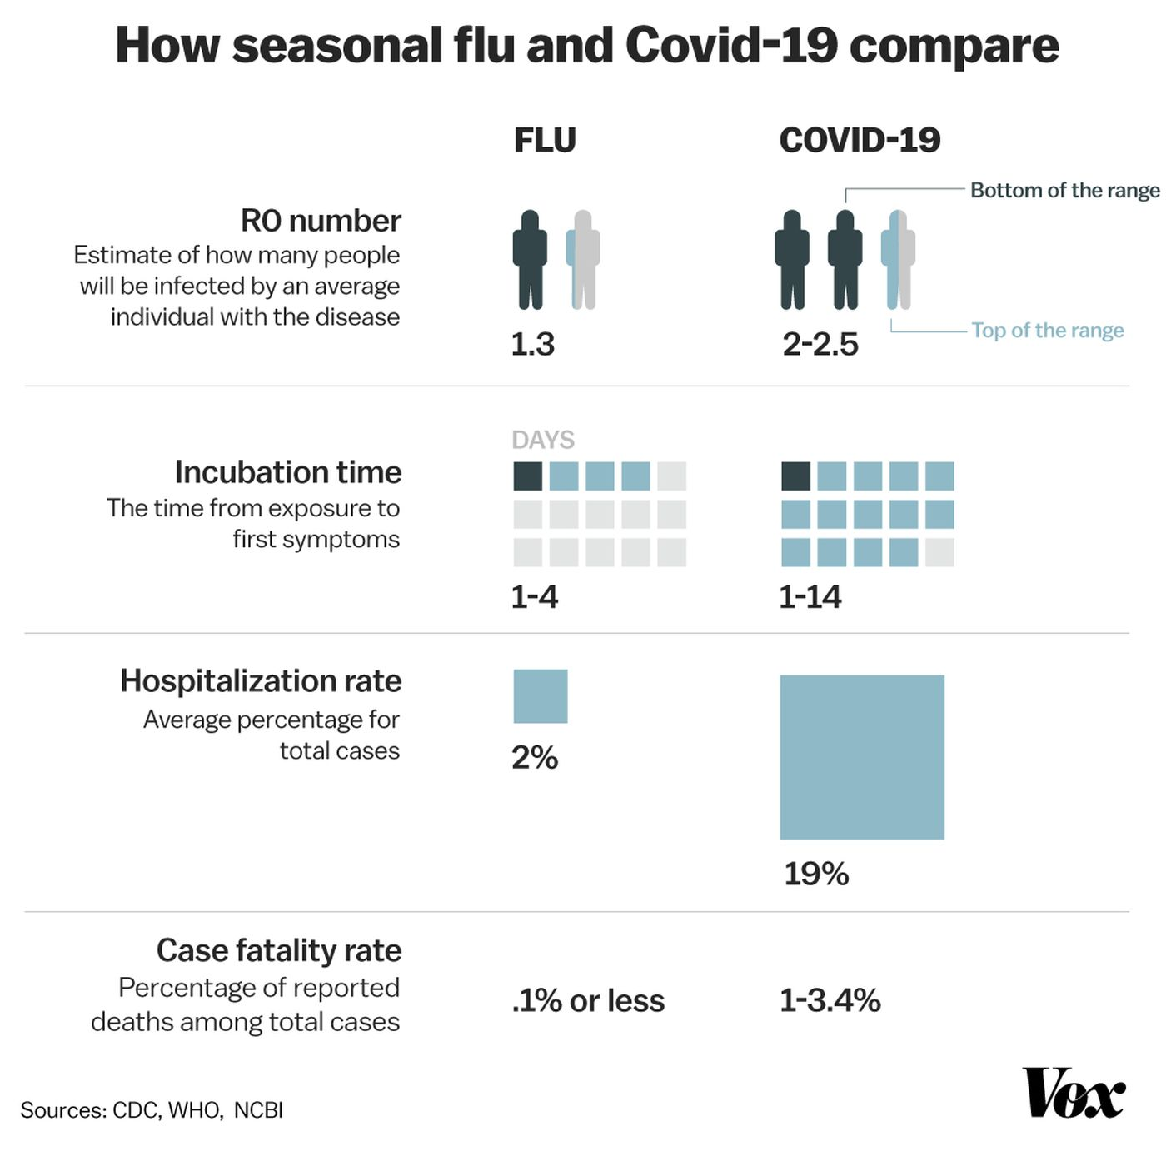
SEASONAL FLU
VS
COVID - 19
Notes:
As we are all aware - Currently, there is no vaccine to combat Coronavirus, nor any approved therapeutics to slow the course of its toll on the human body.
As mentioned in the previous slide while a person with flu can infect an average of 1.3 person, a person with coronavirus can infect an average of 2.2 persons.Biologically, it behaves differently than the flu. It takes one to 14 days for people with Covid-19 infection to develop symptoms. For the flu, it’s around two days. That potentially gives people more time to spread the illness asymptomatically before they know they are sick. The hospitalization rate for COVID is 10 times higher than the seasonal flu and thus has a higher potential to overwhelm the healthcare system and hurt people with other illnesses. It's important to note that the death rate of COVID – 19 can vary by location, age of person infected and the presence of underlying health conditions · While the exact death rate is not yet clear, the evidence so far does show that if a person is infected they are 34 times more likely to die of COVID-19 than a seasonal flu.
I would like to handover to Debasri to continue our presentation from here.

Slide 9
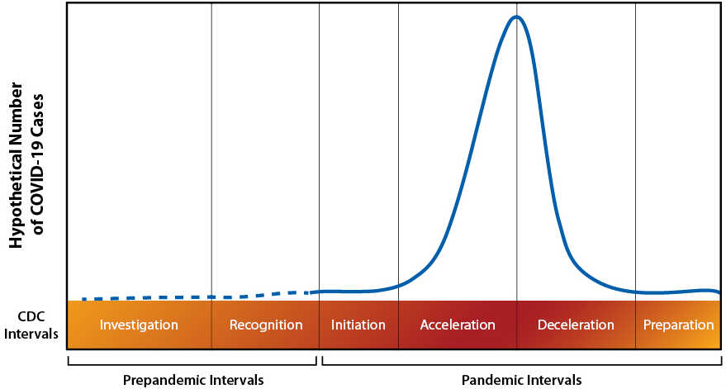
PANDEMIC LIFE CYCLE
Like other pandemics, it follows a life cycle pattern:
Outbreak
Acceleration phase
Inflection point
Deceleration phase
Stop or ending phase
Notes:
A pandemic is defined when an infection has “efficient and sustained human to human transmission worldwide.” Some recent prior pandemics have included HIV/AIDS 2005, Hong Kong Flu pandemic 1968, and the Asian Flu pandemic of 1956.
The evolution of COVID-19 is not completely random. Such a life cycle is the result of the adaptive and countering behaviours of agents including individuals (avoiding physical contact) and governments (locking down cities) as well as the natural limitations of the ecosystem.

Slide 10

GOAL
What trends are we seeing earlier and now?
Build a model that can predict recovered cases knowing confirmed cases and deaths.
Predict number of recovered cases at a given date.

Slide 11
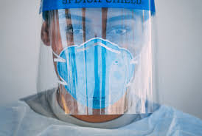
RECENT NUMBERS
OUR DATA ATTRIBUTES
Total Number of countries reporting cases: 220
Confirmed cases worldwide: 3041764
Deaths worldwide: 211167
Recovered cases worldwide: 893967
Active cases worldwide: 1936630
Closed cases worldwide: 1105134
Confirmed cases Per Day: 31358
Deaths cases Per Day: 2176
Recovered cases Per Day: 9216
Notes:
April 27 Data
data was made available as csv files in the Johns Hopkins Github repository

Slide 12

ANALYSIS
Some interesting questions we wanted to answer.
How many, where, when?
What are the Patterns?
What will happen next?

Slide 13
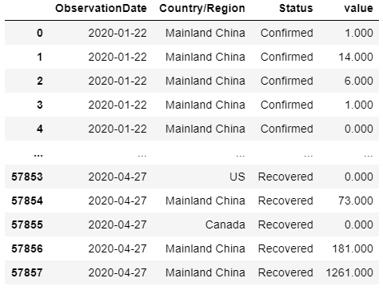
Which data to use? Where to find it?
Data used for this analysis was obtained from the Johns Hopkins Github repository.

Slide 14
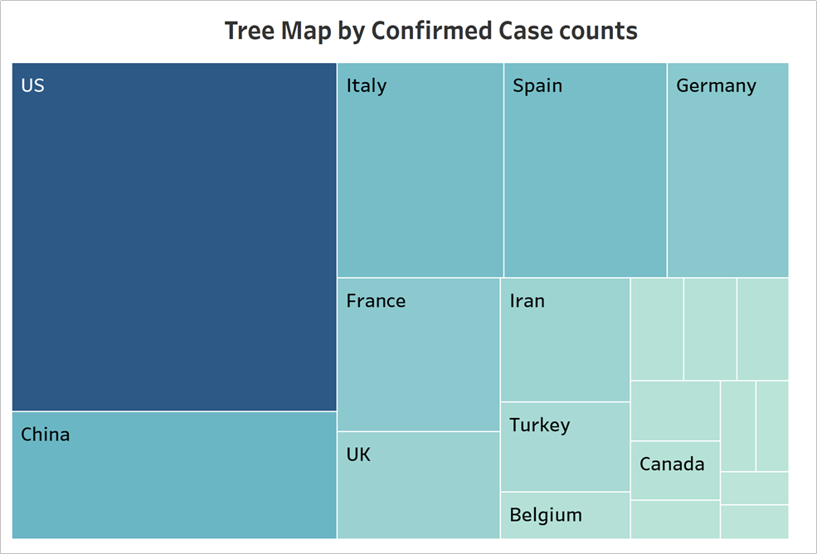

Slide 15
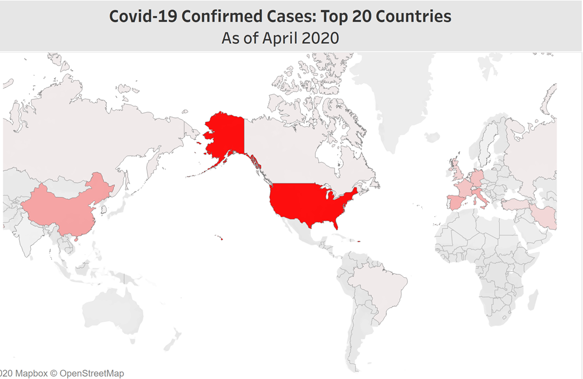

Slide 16
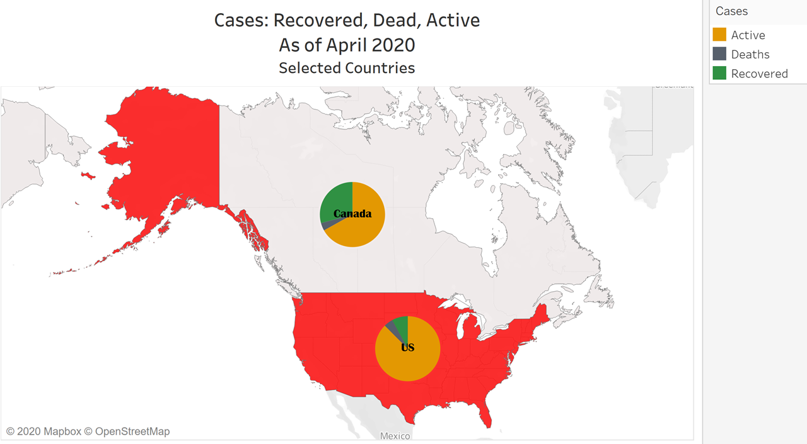

Slide 17
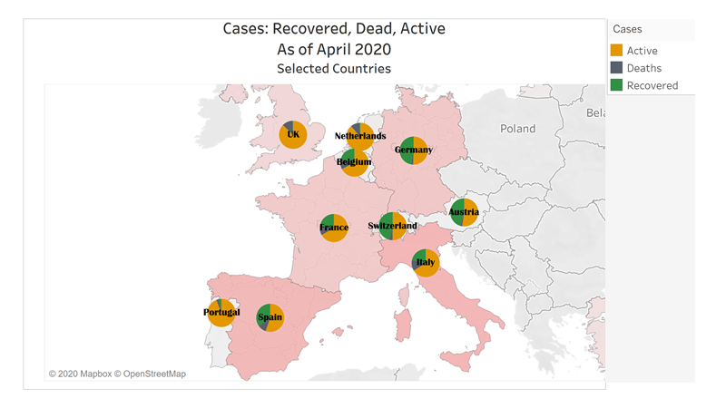

Slide 18
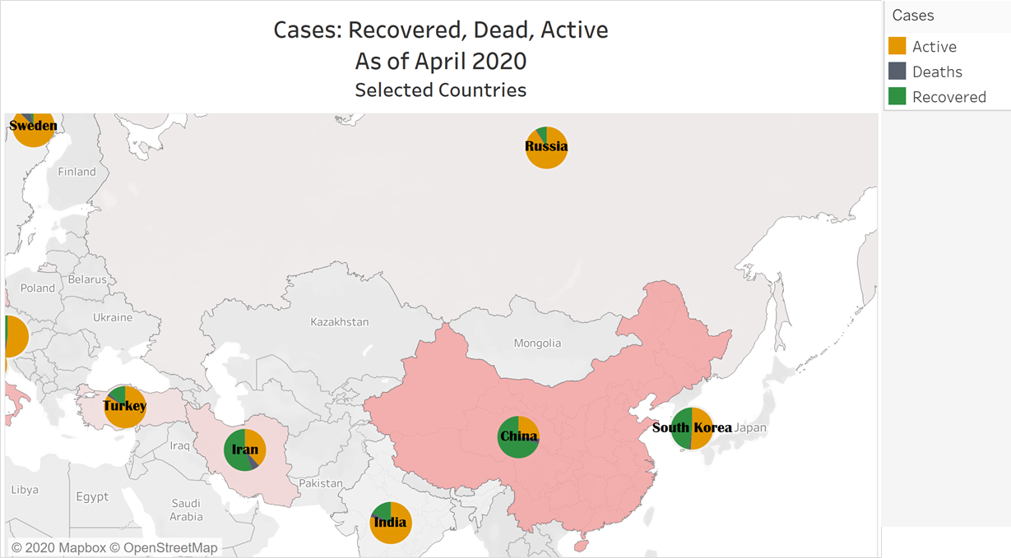

Slide 19
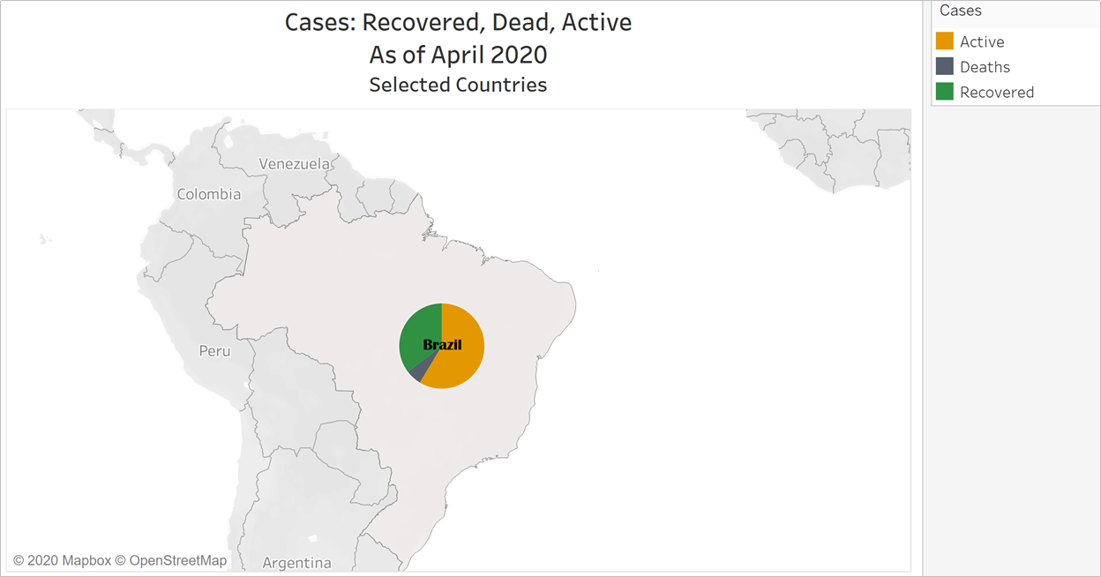

Slide 20
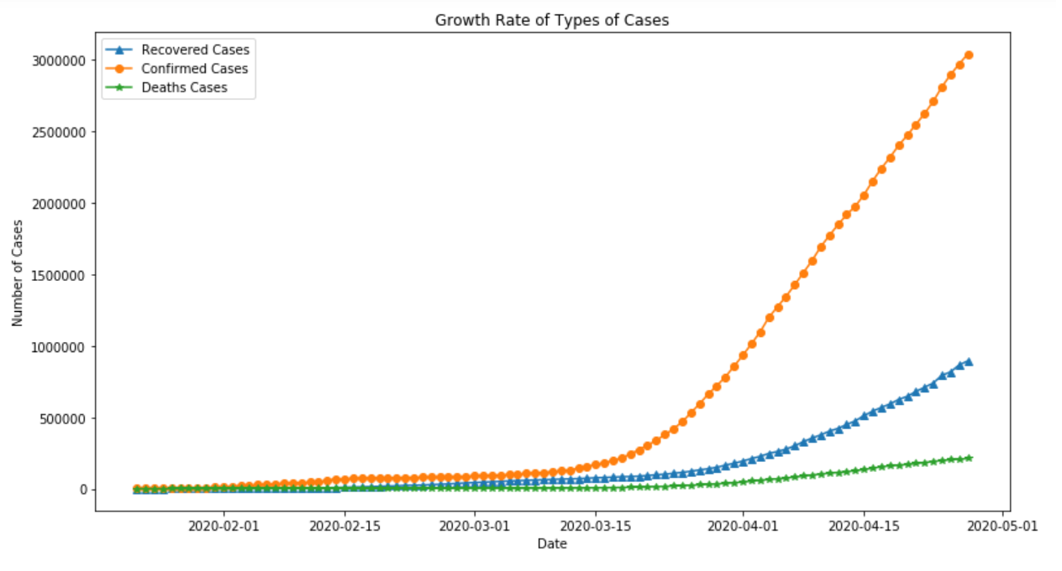
WORLDWIDE GROWTH RATE
Notes:
Here we have a graph showing the different types of cases ove the time of the data collection, from Jan. 22, 2020 to four days days ago, April 27, 2020.
The organge line tells us the rate of growth in confirmed cases over time, the blue line tells us the rate of growth in Recovred cases over time, and the green line is the rate of growth of deaths over time
We can see the rate increase in confirmed cases to an exponential growth starting around mid- March. This is when more tests were made available world wide and confirmed reports increased. Soon after we started to see an increase in Recovered and Death Cases in late March, fortunately with a higher rate of Recovered cases to death cases

Slide 21
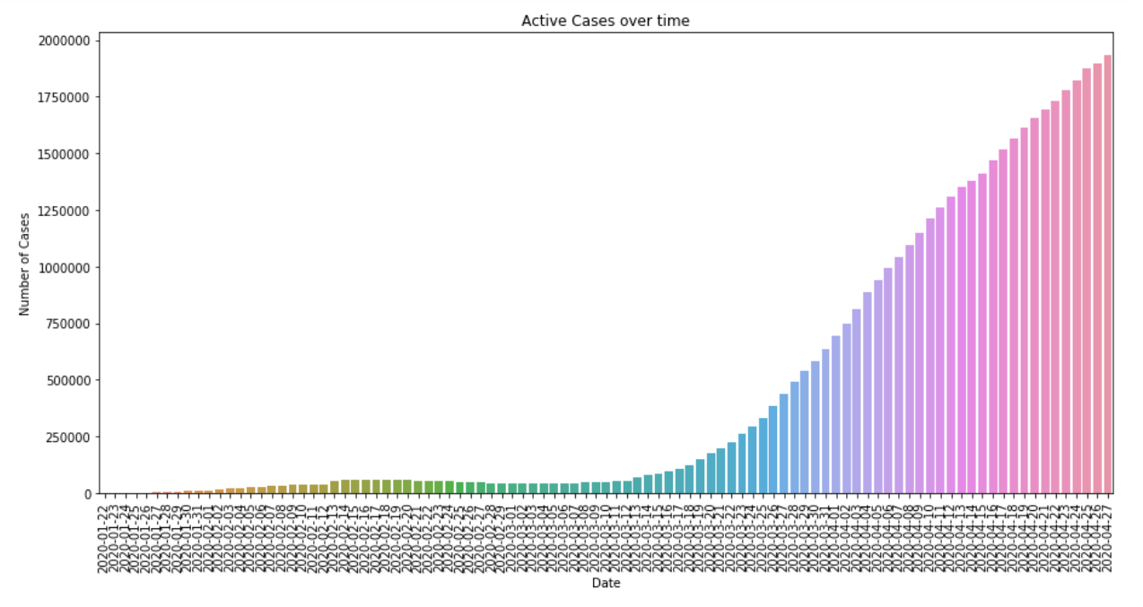
ACTIVE CASES
Active = Confirmed - Recovered - Deaths
Notes:
If we look at just the Active cases in this Bar Plot on a daily basis, where Active cases are any cases that haven’t recovered or reported deaths.. Around 3/13 we see an exponential growth begin. Around April 15th we see a very slight slow down in the increase in Active cases but the rate is nowhere near a flattening curve that we would like to see.

Slide 22
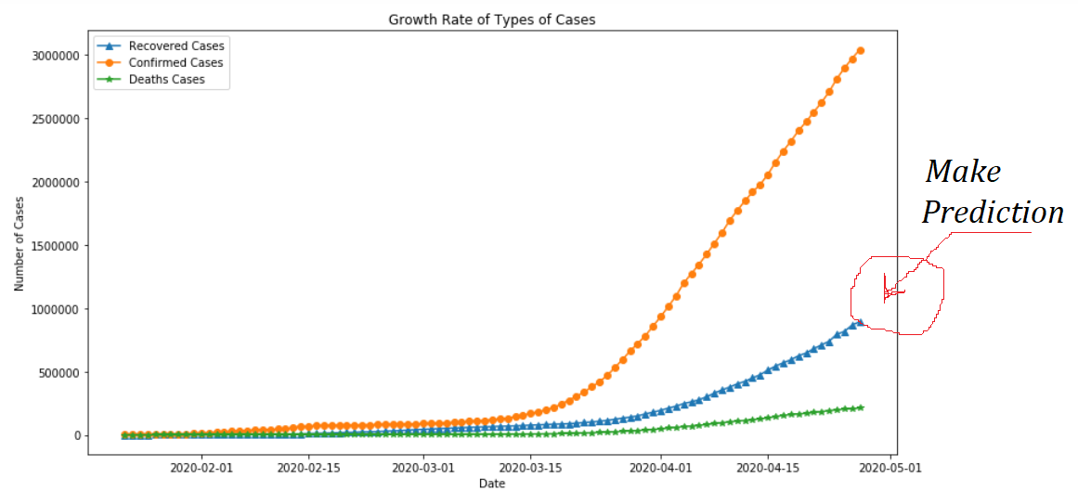
MODELING
Linear Regression
Support Vector Machine Model
Holt’s Winter Model
Notes:
rate worldwide
This is the trend of the cases since jan 22, 2020
Using the active cases model to predict future Recoveries
So looking at our data we wanted to see, knowing the information we know about the trend, can we predict how many recovered cases there will be at a future date. We used three different predictive models: Linear Regression, Vector Support Model, and Holt’s Winter Model

Slide 23
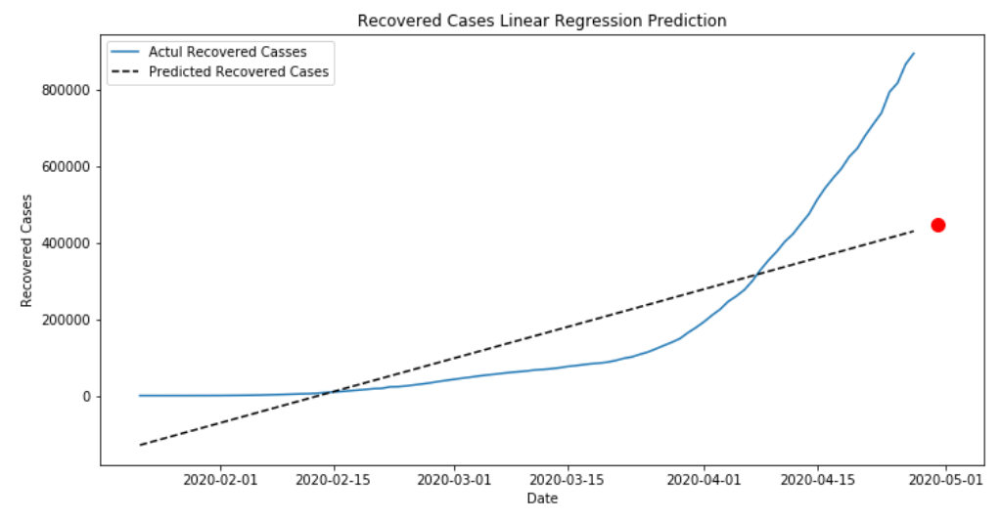
LINEAR REGRESSION
R² = 0.8459
Notes:
So here is our Linear Regression Model, This a visual showing the dotted line as our model where the red dot is a point that was predicted using the model and predicting the number of cases at a later date

Slide 24
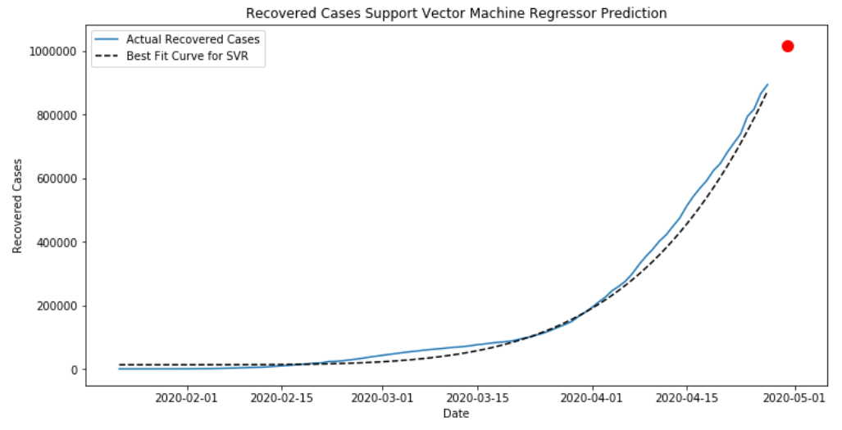
SUPPORT VECTOR MACHINE REGRESSION
R² = 0.9305
Notes:
We made a second model to see if we will get a better fit model.
We predicted that number of cases on the date will be little over one million

Slide 25
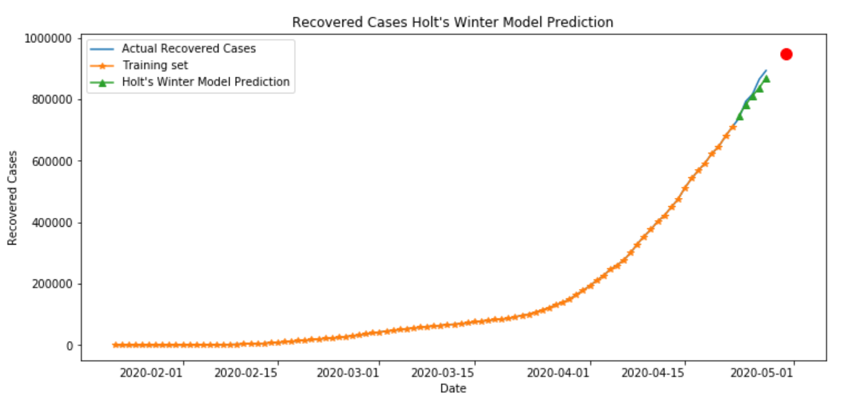
HOLT’S WINTER MODEL

Slide 26
ERRORS
Model Name | Root Mean Squared Error
Holt's Winter Model | 17505.20637
Support Vector Machine Regressor | 25987.05829
Linear Regression | 239341.8704

Slide 27
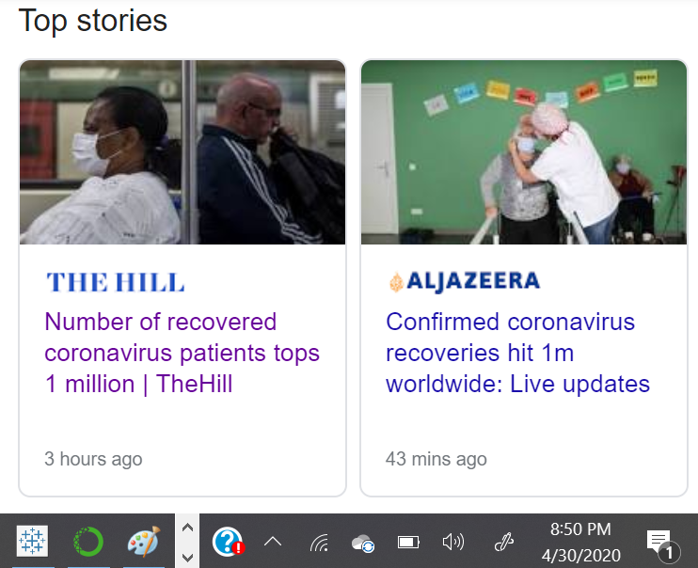
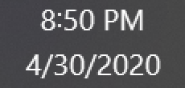
RESULTS
Dates | Linear Regression Prediction | SVM Prediction | Holt's Winter Model Prediction
4/28/2020 | 435389.855 | 919823.383 | 894224.069
4/29/2020 | 441210.071 | 967549.232 | 926732.587
4/30/2020 | 447030.287 | 1017263.341 | 948588.749
5/1/2020 | 452850.503 | 1069027.196 | 994870.697
5/2/2020 | 458670.7201 | 1122903.537 | 1032121.472

Slide 28
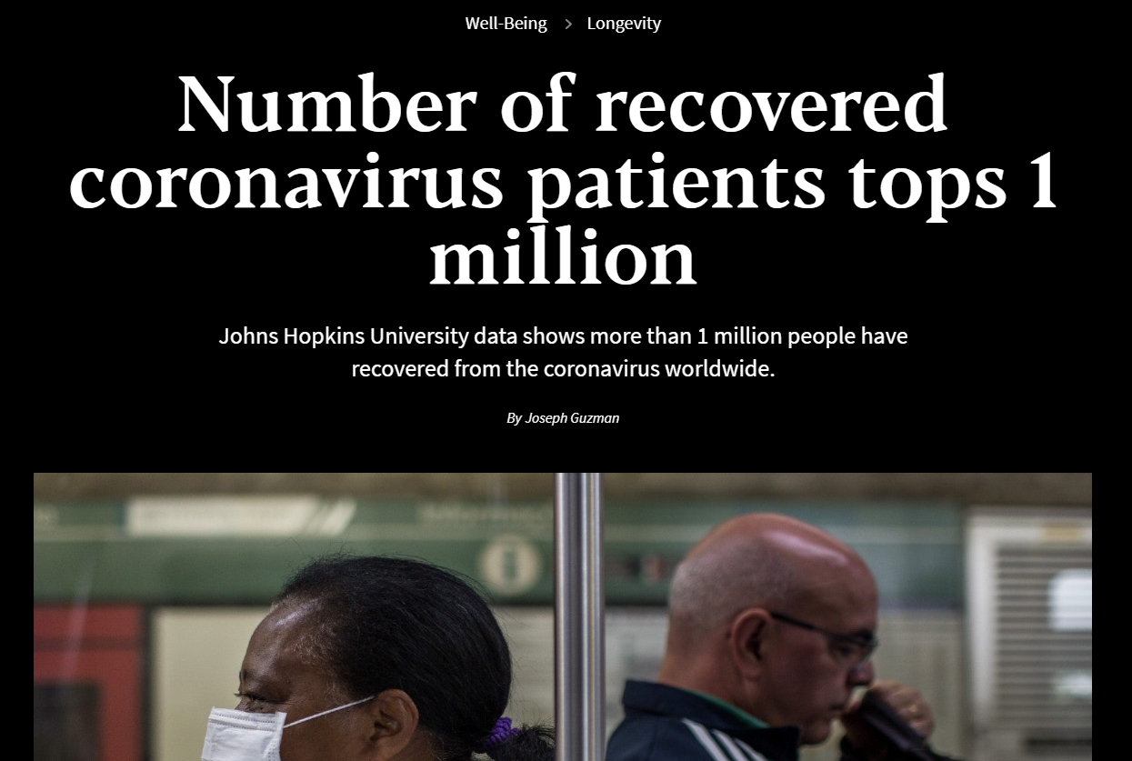
CONCLUSION
Discovered trends
Built Models
Made Accurate Predictions
Notes:
So, in conclusion with the initial goal to understand COVID 19 and the cases worldwide and to discover the trends of each type of case
Using that information, we successfully built three different models to predict the number of Recovered Cases at a future date. Our two more accurate models, predicted just below and above the top analysis predictions today, where Johns Hopkins University’s analysis shows (on a positive note) that there are just over a million people recovered as of yesterday, April 30, 2020

Slide 29
RESOURCES
https://www.kaggle.com/neelkudu28/covid-19-visualizations-predictions-forecasting/notebook
https://github.com/CSSEGISandData/COVID-19
https://www.google.com/search?q=total+reported+covid+cases+worldwide&oq=total+reported+covid+cases+worldwide&aqs=chrome..69i57.12984j0j7&sourceid=chrome&ie=UTF-8
https://people.sutd.edu.sg/jianxi_luo/public_html/COVID19PredictionPaper.pdf
https://ourworldindata.org/coronavirus-source-data
https://covid.ourworldindata.org/data/owid-covid-data.csv
https://thehill.com/changing-america/well-being/longevity/495558-number-of-recovered-coronavirus-patients-tops-one

